Slide 1
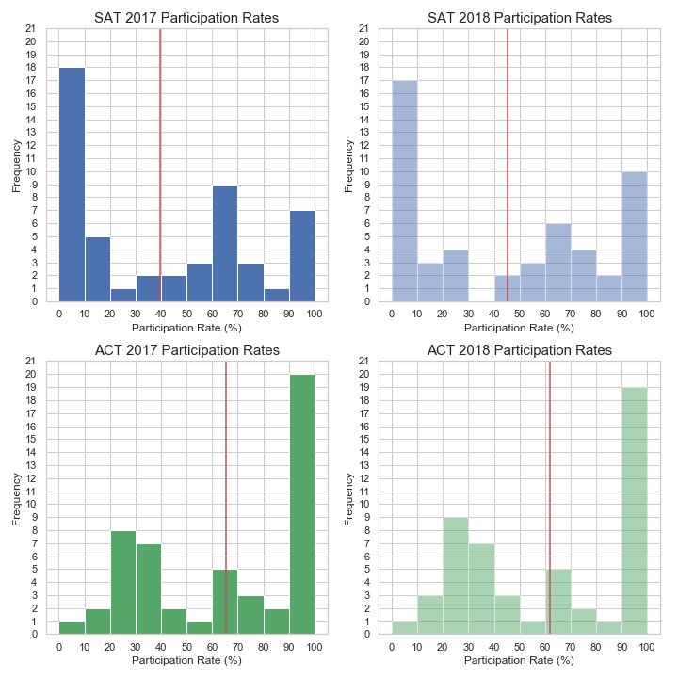
The Problem
SAT participation rates so low
Mean: 39.8%
Mean:
45.2%
Mean: 65.2%
Mean: 61.7%

Slide 2
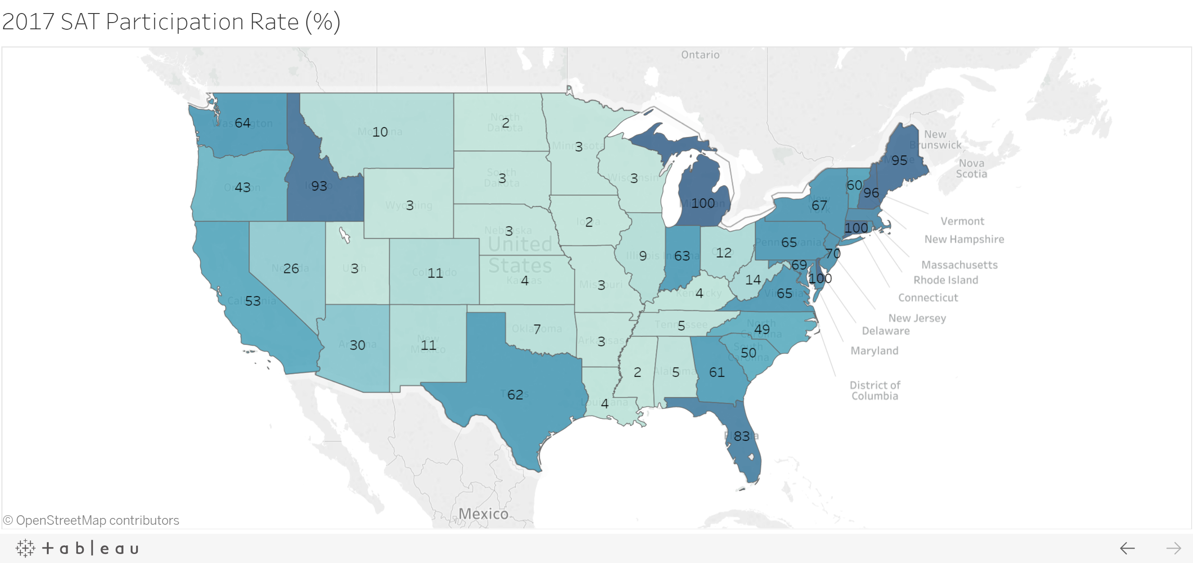
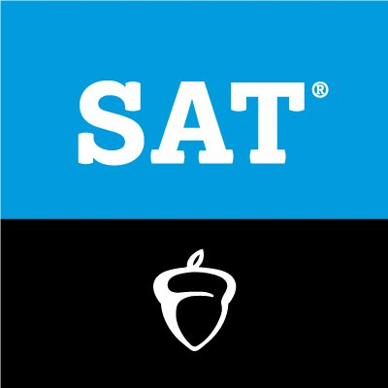

2017
Notes:
Chloropleth Map of the US participation rates of SAT (2017)

Slide 3
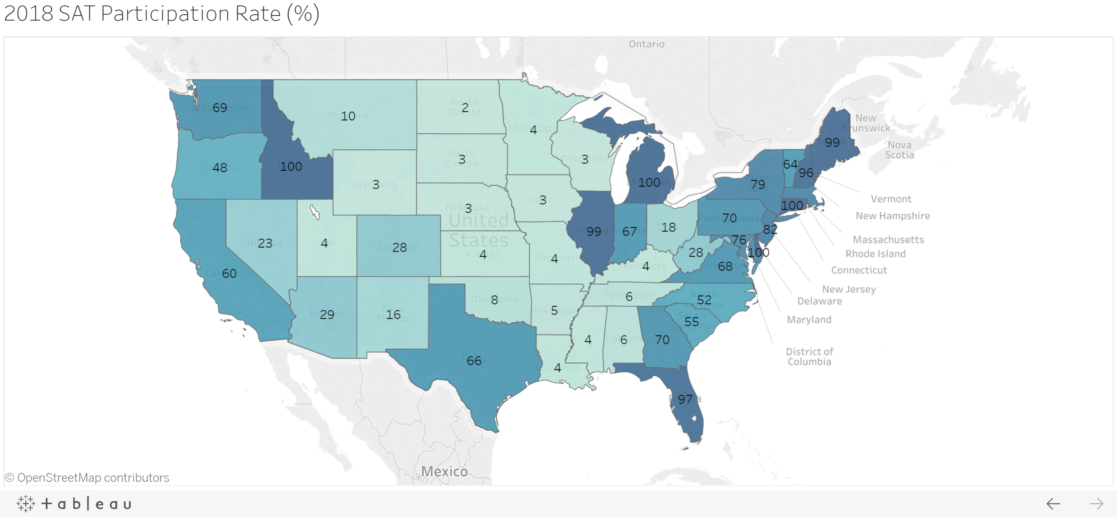
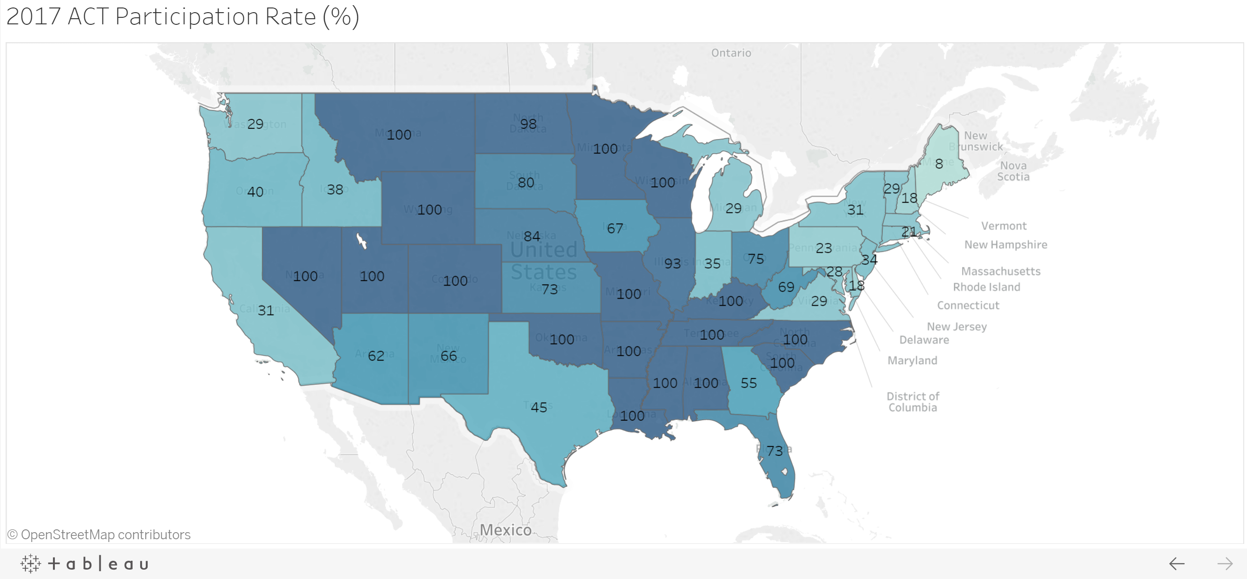

2017
Notes:
Compare to ACT

Slide 4
2017
Notes:
Bring attention back to SAT

Slide 5
2017
Notes:
Choropleth Map of the US participation rates of SAT (2017)

Slide 6
2018
Notes:
Choropleth Map of the US participation rates of SAT vs. ACT (2018)

Slide 7
Overview
SAT Participation Rate Changes 2017-2018
Summary Statistics
Top Increases
Statistic | SAT Participation Rate Change
Mean Change | 5%
Standard Deviation | 13%
Lowest | -8%
1st Quartile | 0%
Median | 2%
3rd Quartile | 5%
Highest | 90%
State | SAT Participation Change | ACT Participation Changes
Illinois | +90% | -50%
Rhode Island | +26% | -6%
Colorado | +17% | -70%
Top Decreases
State | SAT Participation Change | ACT Participation Changes
DC | -1% | 0%
Nevada | -3% | 0%
Arizona | -8% | +4%

Slide 8


Deep Dive: The State of Illinois
Background: Changes in Requirements
PSAE Exam (2010 – 2014)
2-day standardized test taken by all High School Juniors
Day 1: The ACT
Day 2: WorkKeys Science Examination
PARCC Exam (2015 – 2017)
Intensive exam offered to both Grade 3 – 8 students and high school
ACT became optional (but still on contract) in 2015
Critics said the test was too long and too hard (Chicago Tribune)
Became controversial as high-stakes graduation requirement.
Abolished once SAT was favored in 2017

Slide 9
Deep Dive: The State of Illinois
Why did the participation rate change so much in just 1 year?
State pays for it!
State subsidy provides an economic incentive to consumers due to reduced cost
…but kind of out of our control!
ACT contract with State of Illinois expired:
ACT board lost the bid to us despite bidding $5.7mm less
State saw cost differential as negligible once spread over 6 year contract life
…so we don’t necessarily need to bid less than our competitors
State needed a less time-consuming test to prepare for to replace the PARCC
Notes:
Requires the SAT and pays for it!
Source: https://www.princetonreview.com/college-advice/act-sat-state-requirements
Similar to Rhode Island, Illinois is abandoning the PARCC
Source: https://www.chicagotribune.com/news/local/breaking/ct-parcc-test-high-school-met-20160711-story.html
CollegeBoard (SAT Administrator) won a 3-year contract (with option for additional 3-year extension) with Illinois state after the state's previous ACT contract expired. Interestingly, ACT's bid was 5.7 million USD lower than Collegeboard's, but the cost when spread over 6 years was marginal for the state's budget
Source: https://chalkbeat.org/posts/chicago/2018/07/27/act-protests-state-boards-embrace-of-rival-test-provider/
The SAT is part of Chicago Public Schools' Rating System: The SQRP. The scores make up 20% of the rating, giving schools an incentive to take the test
Source: https://chalkbeat.org/posts/chicago/2018/07/27/act-protests-state-boards-embrace-of-rival-test-provider/
Part of decision influenced by partnership with Khan Academy to provide free SAT prep resources, something the ACT does not have with them
Source: https://www.chicagotribune.com/news/ct-illinois-chooses-sat-met-20160211-story.html

Slide 10
Wrapping-Up
Takeaways
From just broad state-level participation data, there is only so much we can glean from the data
From the choropleth map, certain regions like the East Coast (particularly New England) are already in our pocket! But the story for rest of the states cases are rather idiosyncratic.
Our deep dive into Illinois provided insight where we see the decision was a shift to a less time-consuming test, and the state subsidy provided an incentive but can we generalize this?
Further Enquiry
Regression Analysis with Y = participation rate
Is less preparation time a statistically significant factor that drives participation rate?
After including state subsidy as an indicator/dummy variable, what other factors are there?
Can we uncover latent idiosyncratic factors that drive participation rate, using Principal Component Analysis?
Contract Theory Optimization Model:
For a given State, what is the optimal bid higher than ACT’s that would make the sponsor see the cost differential as negligible?

